Slide 1



Options 2025

Slide 2

Choosing the right future for you
Think about what you enjoy.
Think about what you are good at.
Think about your future, and careers paths that you may want to follow.

Slide 3
Why Are GCSE Options Important for Your Child's Future?
Building a Foundation for Future Education
GCSEs are the stepping stones to A-levels, vocational courses, or apprenticeships. Choosing the right subjects keeps doors open for future educational opportunities.
Developing Key Skills
GCSEs equip students with transferable skills like:
  - Critical thinking and problem-solving.
  - Creativity and communication.
  - Practical knowledge in areas like business and technology.
Fostering Interests and Motivation
Subjects aligned with your daughter/son's interests can:
  - Boost engagement and enjoyment.
  - Lead to better grades and a positive experience.

Slide 4
Why Are GCSE Options Important for Your Child's Future?
Keeping Options Open
A mix of academic and practical subjects:
  Broadens your daughter/son's learning experience and ensures they don’t limit future choices too early.
  Facilitating subjects (e.g., languages, humanities) are valued by universities and employers.
Supporting Decision-Making
  Help your daughter/son by encouraging research into career requirements and discussing their strengths and interests. Thoughtful choices reduce regret and ensure a smoother academic journey.

Slide 5
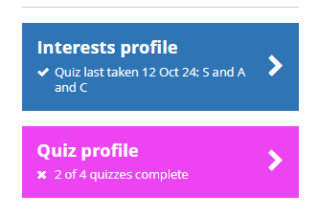
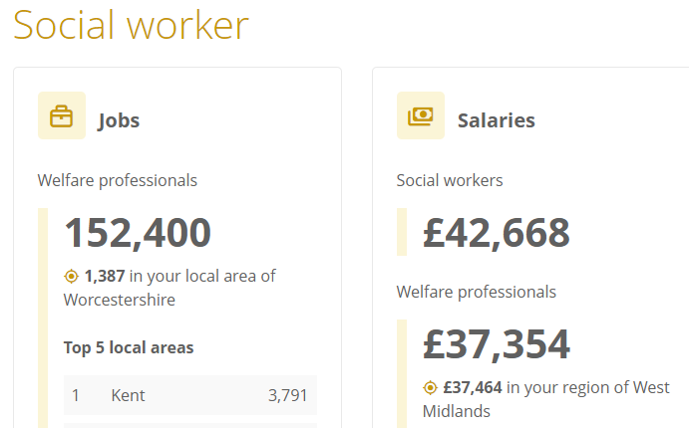
What resources do I have to help me decide?
Unifrog
This is Bewdley School's careers platform, and it contains a huge amount of information and support about careers and subjects.
Students can complete quizzes to help provide ideas
Students can also look at different careers to see where their subject choices could take them. At the bottom of each career there is LMI
An appointment with Mrs. Korischar to talk through your ideas. There are drop-in sessions available

Slide 6
Your Curriculum / timetable
Maths | English |  | Science |  | Language
Creative | Option A | Option A | Option B | Option B
Core PE |  |  | Humanities
RE |  |  | Personal Development

Slide 7
Creative Subjects
Select one subject from this group
Pick 2 further subjects from this list
Note: You cannot choose both Art and Textiles.
Choose a Humanities subject
Geography
History
Continue with current language
Textiles
Language
Computer Science
Health and Social Care
Media Studies
Design and Technology
Your Curriculum / timetable
Maths | English |  | Science |  | Language
Creative | Option A | Option A | Option B | Option B
Core PE |  |  | Humanities
RE |  |  | Personal Development
Drama
Business and Economics
Textiles
Art
Hospitality and catering
Design and Technology
Psychology
Computer Science
Hospitality and catering
Music
Design and Technology
Music
History
Art
Drama

Slide 8

Why these choices matter…
You will only be able to continue to study subjects in year 10 and 11 if you have done them in year 9
The options process involves 2 distinct phases:
  Phase 1 (Now) – students select 3 subjects to trial options in year 9.
    In the Autumn term of Year 9 there is a short opportunity for students to change and trial a different subject. However, this is only if there is capacity within groups, and if timetables allow the change.
  Phase 2 (Spring term of year 9) – students select 4 final options for study at GCSE or equivalent level in years 10 and 11.
EXAMPLE
  If you do not do textiles in year 9 you will not be allowed to do this in year 10
  If you do not do History in year 9 you will not be allowed to do this in year 10

Slide 9
Year 8 Option Blocks
Block J | Block K | Block L | Block M
Art* | Business | Business | Art*
Business | Computing | Design Tech* | Business
Drama* | Health and Social Care | Hospitality and Catering* | Computing
Design Tech* | Media | Health and Social Care | Hospitality and Catering*
Hospitality and Catering* | Music* | Music* | Media
Media | Design Tech* | Textiles* | Textiles*
PD/RE | PD/RE | PD/RE | PD/RE

Slide 10
How does the process work?
Wednesday 12th February – Parental launch for option process.
Tuesday 25th February – Year 8 parents evening (virtual).
Wednesday 26th February – Option choices go ‘live’. A link will be sent to students to enable option choices to be made
Wednesday 12th March – Deadline for students to select options.
Summer Term – Students will be notified of their Year 9 Options.
Your Curriculum / timetable
Maths | English |  | Science |  | Language
Creative | Option A | Option A | Option B | Option B
Core PE |  |  | Humanities
RE |  |  | Personal Development

Slide 11
Frequently asked questions
If I don’t take a subject now does that mean I can't do it at GCSE?
  Correct – this is why the choices are important. You may be able to swap just before Christmas, but there are many restrictions on this due to timetable constraints and group sizes. We will try to accommodate any swaps but can’t guarantee it is possible.
Am I guaranteed to get all of my subject choices?
  No. We try very hard to give every student their first choice, but we make no guarantees. You must be happy with all your choices including reserves
If a course is oversubscribed, then the criteria for selection will include:
  Suitability based on attainment and progress in the subject or similar subject
  Prepared for learning in the subject e.g. equipment
  Submitting choices once the deadline has passed
  Attendance & Behaviour

Slide 12
What support is on offer?
Career support
  Mrs Howard KHO@bewdley.worcs.sch.uk
  Mrs Korischar – SKO@bewdley.worcs.sch.uk
Form tutors - @bewdley.worcs.sch.uk
Carl Horton, Head of Year 8 – CHO@bewdley.worcs.sch.uk
Jill Rickards, Extended Leadership team and Head of Sixth Form – JRI@bewdley.worcs.sch.uk
Subject specific videos.
Option choices information booklet.

Slide 13
Any Questions?
?

